Slide 1
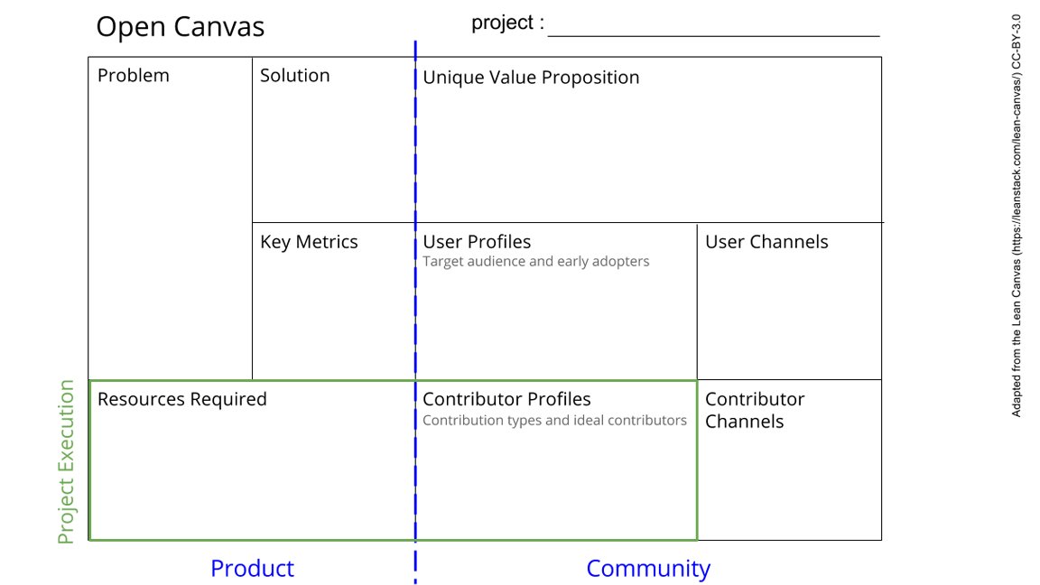
Building the Research Software Engineering (RSE) Association in Asia Region
Open source projects are becoming more popular in tech industry. The RSE community has its presence in certain regions. We want to build the same in Asia region too.
We start by building a community where people can join each other.
There is no community as of now. We are building the infrastructure for the same. It would help people to join together.
Building of the infrastructure for the community, events for active participation
We would gain new users via conducting simple group activities like simple hackathons, book-reading, etc.
Anyone interested in RSE in general from Asian countries.
We need to build a website, need expertise to do so. Also, we are getting the hang of Github for project management. Our emphasis is on creating a collaborative project maintained via GitHub and more.
Website design experts, GitHub experts, the global RSE community, and all those who want to join in our community to reap the benefits of RSE and community work.
By speaking to the OLS mentors and cohort, and also the global RSE society.
See next slide for instructions!
Notes:
Go to File > Make a Copy… to make your own canvas
See next slide for instructions

